Slide 1
Super Scuba
Super Scuba offers the following:
Basic training
Advance training
Use of our training pool
Use of our equipment
Guided tours to diving locations
Notes:
Welcome to Super Scuba. During this presentation you will be given lots of information about scuba diving and what we can offer you.

Slide 2
Equipment
To scuba dive you need this equipment:
Diving Mask
Flippers
Snorkel
Regulator and Breathing Tank
Wetsuit
Notes:
This is a list of essential equipment that you will need before you can learn how to scuba dive.

Slide 3
Best Places to Dive
This chart shows the best places to dive:
Notes:
This chart shows you the best places to dive based on how many dives take place in each location each year

Slide 4
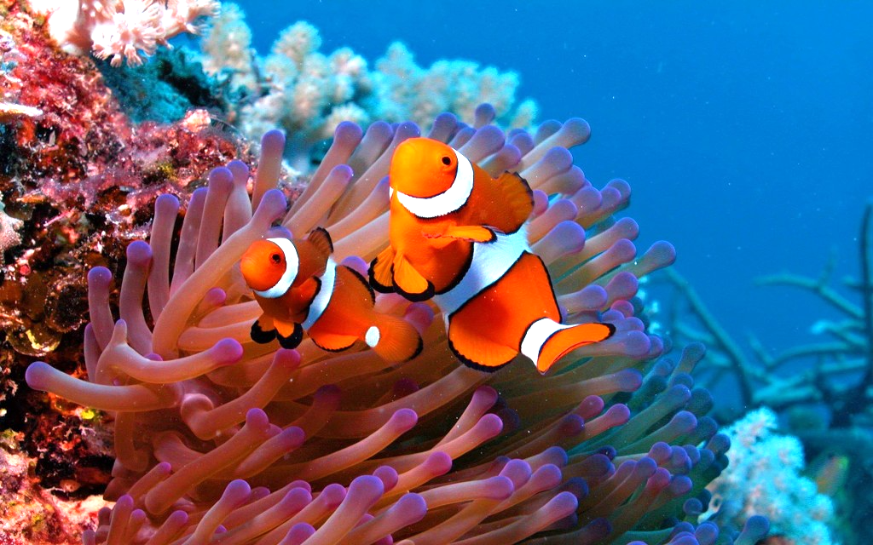
Fish you may see
Scorpion Fish
Clown Fish
Butterfly Fish
Parrot Fish
The beautiful clown fish
Notes:
This is a list of exotic fish that you could see whilst scuba diving in one of the locations shown on slide 3

